Slide 1
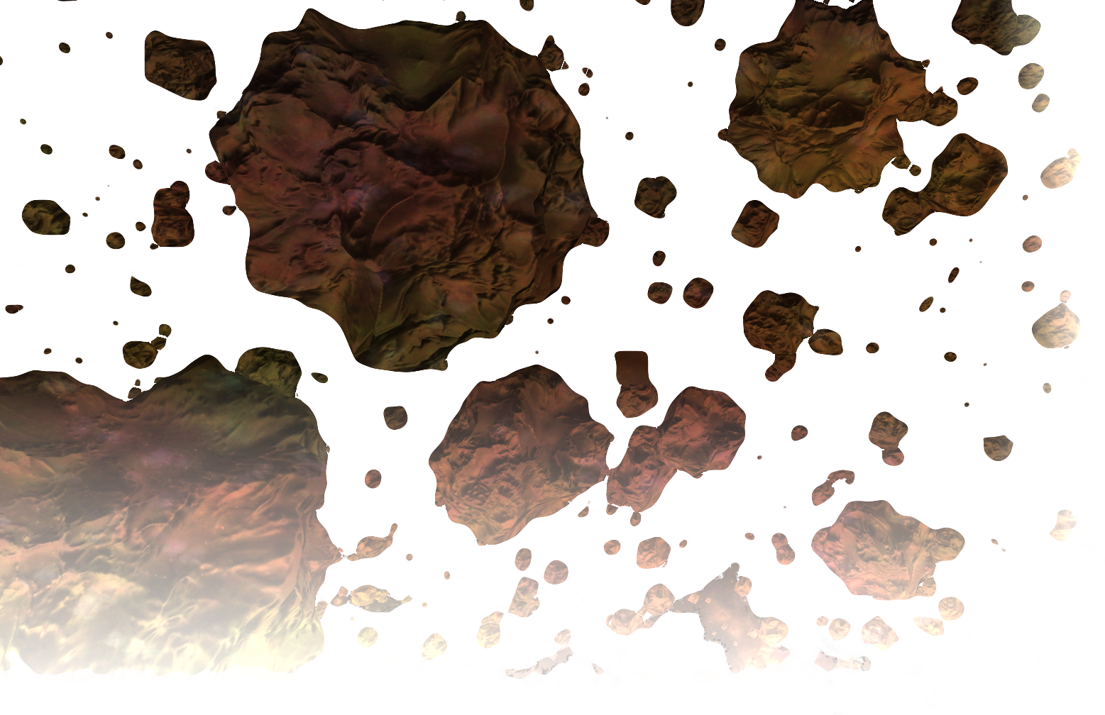
Gameprogramming WS2013/14 „Futurella“ von Pavel Belskiy und Felix Niemeyer Betreuer: Stefan Buschmann

Slide 2
Demo

Slide 3
Wesentliche Technische Aspekte
→ UI mit cegui
→ Server – Client Architecture
Game Objects
GameInstanceServer vs. GameInstanceClient
→ Planet Rendering
Height and Normal Map generation
Tesselation
Planet Geometry Management
Lightning & Deferred Rendering Implementation
→ Ship Rendering
→ Particle Usage

Slide 4
UI
picture
- Integration as osg::Geode
- Provides …
- We use it for:
Console
Menus
picture

Slide 5
Server Client Architecture
Message Peers wie warden nachrichten
Vereinfachtes Klassendiagramm
(reduziertes signavio diagram)

Slide 6
Server Client Architecture
Die GameInstance
GameInstanceClient | GameInstanceServer
Physics … | Rendering
Bild für aufgabe 2
Bild für aufgabe 1
Bild für aufgabe 1

Slide 7
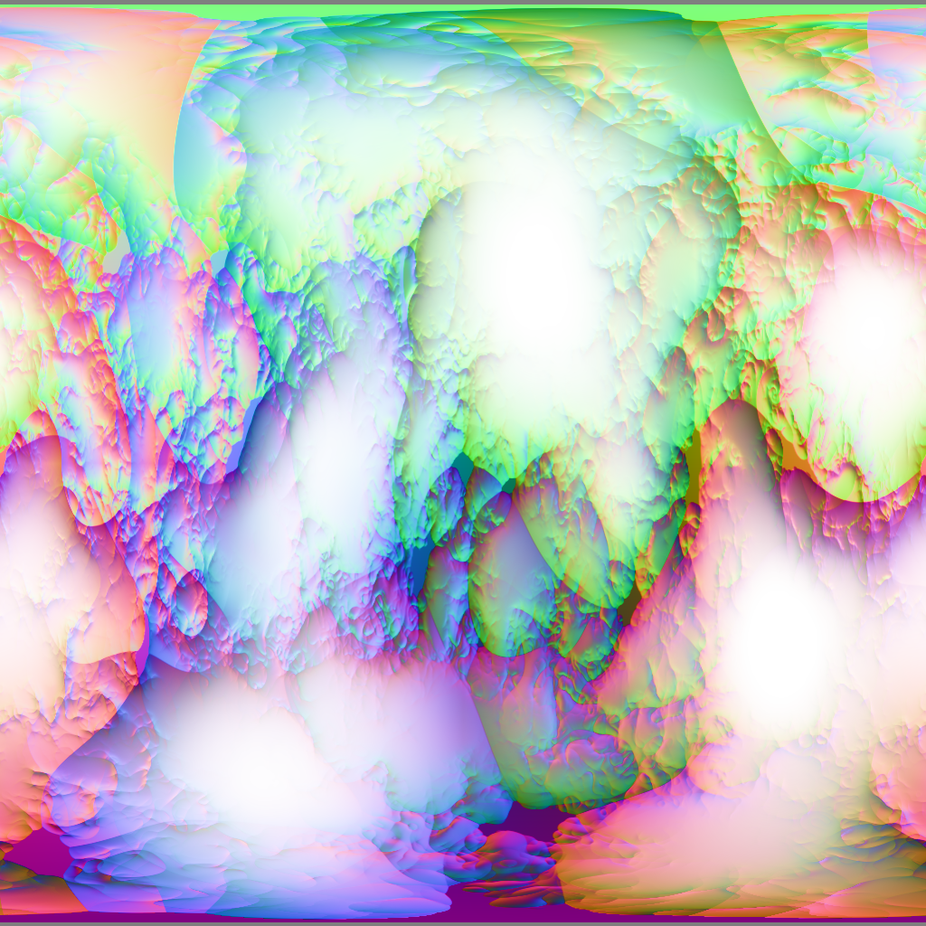
Planet Rendering
Generate spherical height&normal-map externally in Qt Application
Height encoded in
Alpha Channel

Slide 8
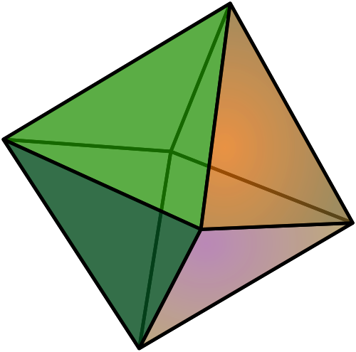
Planet Rendering
→ Tesselate Octahedron
How (vertexattribs)
Is (tc shader)
This (te shader)
Done?

Slide 9
Geometry Management
→ Chunks
How (vertexattribs)
Is (tc shader)
This (te shader)
Done?
→ Vertexdata Callback
…

Slide 10
Lightning & Deferred Rendering
→ Rendering Layers
Colors
Normals
Material
→ Screen Quad Fragment Shader
Use normal & cubelightmap for diffuse and specular lighning
Picture of Colors-texture
Picture of Normals-texture

Slide 11
Ship Rendering
→ Models
Modelled in blender
→ Vertexdata Callback
Reflection with Env map

Slide 12
Particles

Slide 13
Thanksalot
☺

